Slide 1
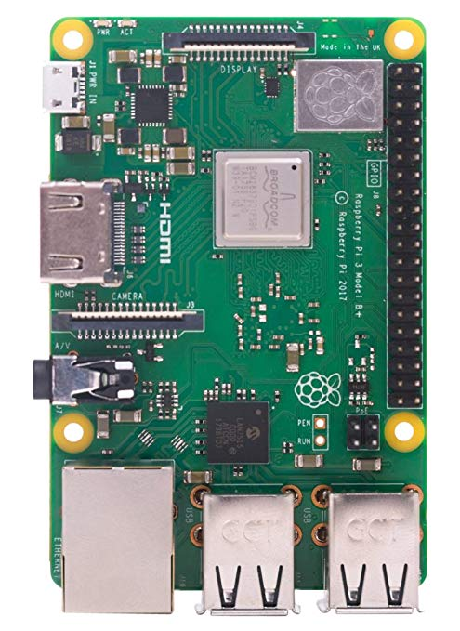
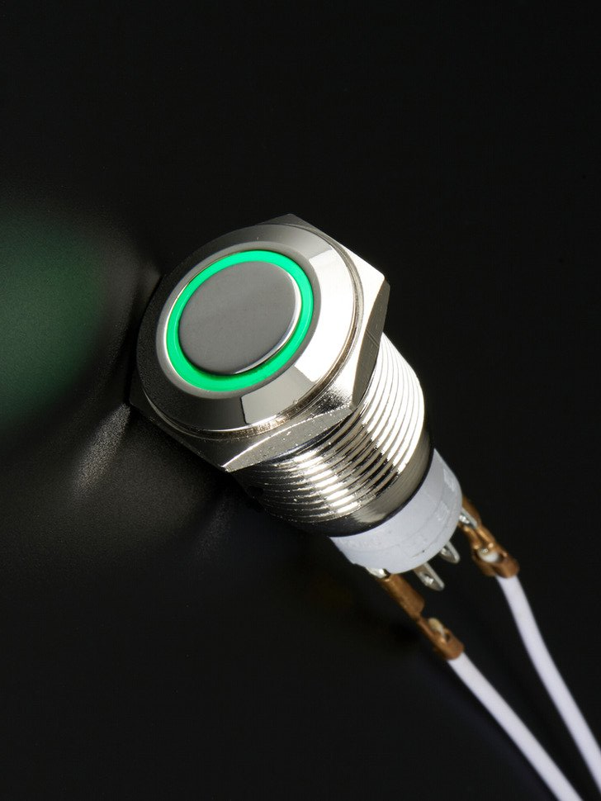
Raspberry PI
Button Interface
Kevin Buranasombati
Devin Rowland
Brandon Aitken
Brandon Menyes

Slide 2
What Do We Hope To Achieve?
The goal of this project is to allow for close to instant feedback when a Quick Print Station is not functioning correctly
When issues occur students will be able to notify a labs and classroom technician with a few presses of a button.
This type of interaction and response hopefully allows for a more positive user experience.

Slide 3
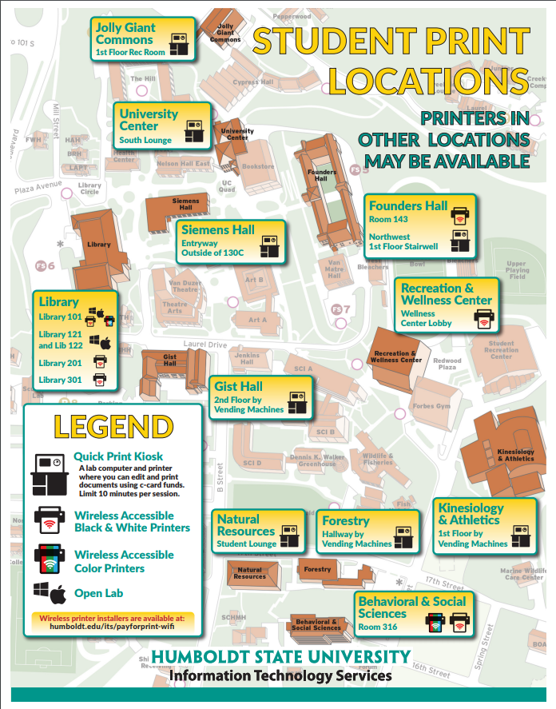
Implementation
Ideally, each Quick Print Kiosk would have a Raspberry Pi, button switch and small monitor.
Labs and Classroom could then view a live status of the state of the Quick Print Kiosk and respond accordingly.

